Slide 1
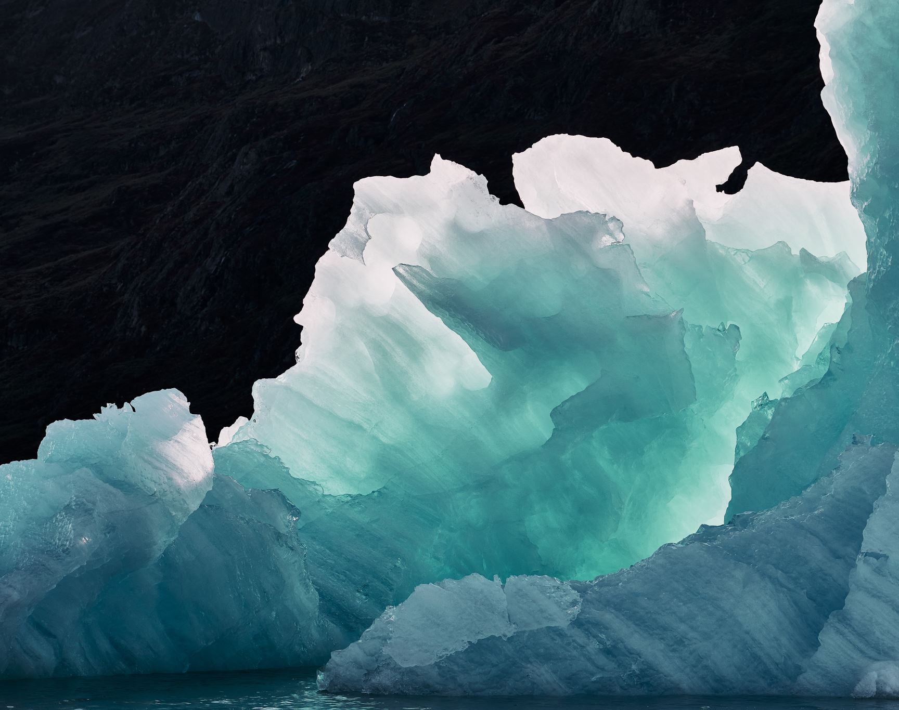
Ice Sheet Modeling and Optimization
Brief introduction to the problem and objectives

Slide 2
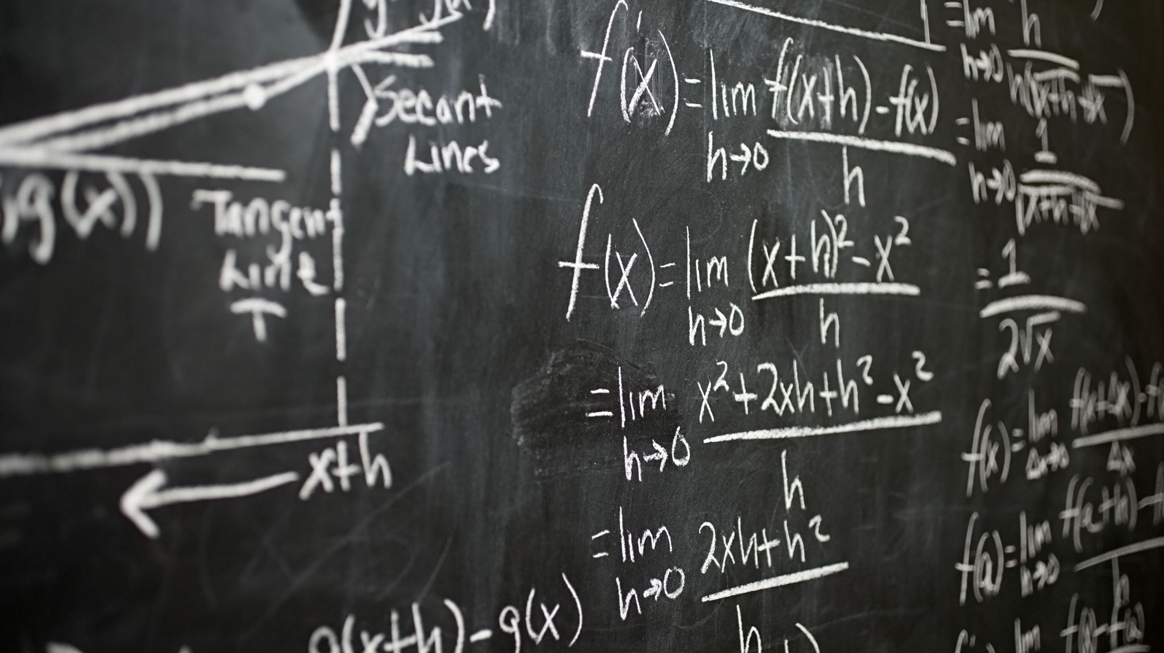
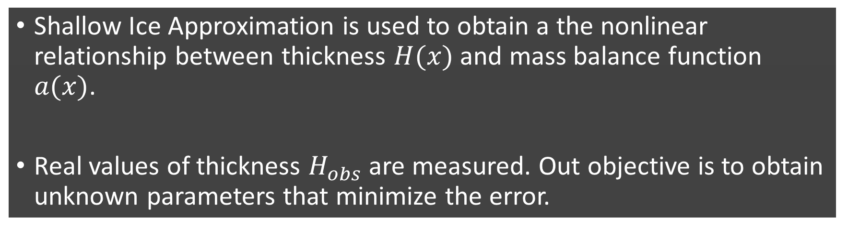
Background
Shallow Ice Approximation is used to obtain a the nonlinear relationship between thickness $H(x)$ and mass balance function $a(x)$.
Real values of thickness $H_{obs}$ are measured. Out objective is to obtain unknown parameters that minimize the error.

Slide 3


Task 1
Theoretical thickness: $H\left(x\right)={\left(−a\left(x\right)\frac{n+2}{2A}{\left(ρg\right)}^{−n}{\left|\frac{ⅆh}{ⅆx}\right|}^{1−n}{\left(\frac{dh}{dx}\right)}^{−1}\right)}^{\frac{1}{n+z}}$
$Objective funtion: f(x)={\left\|H\left(x\right)−H_{obs}(x) \right\|}_{2}^{ }$
Initial rate factor: $A={10}^{−25}$
$n$ that minimizes the objective function, using fminunc: $n= 2.7633$

Slide 4

Task 2
Use the value of $n$ you find in Task 1, try to find $A$ to minimize $f$. Did you get a different $A$ value than 10−25?
$$A = 1.0064e−25$$

Slide 5
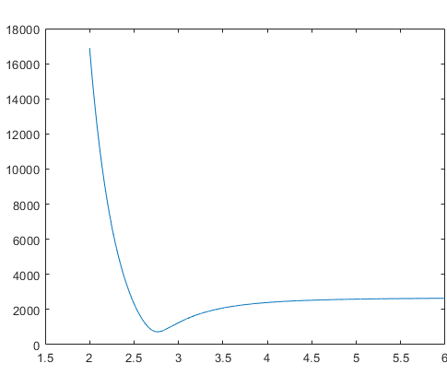
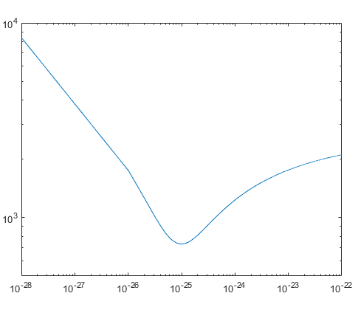


Visualization of the objective functions
$$\text{fixed} A={10}^{−25}$$
$$\text{fixed} n=2.7633$$

Slide 6

Task 3
Change the initial guess in Task 1 and 2, redo the tasks. Do you get different optimal solutions?

Slide 7
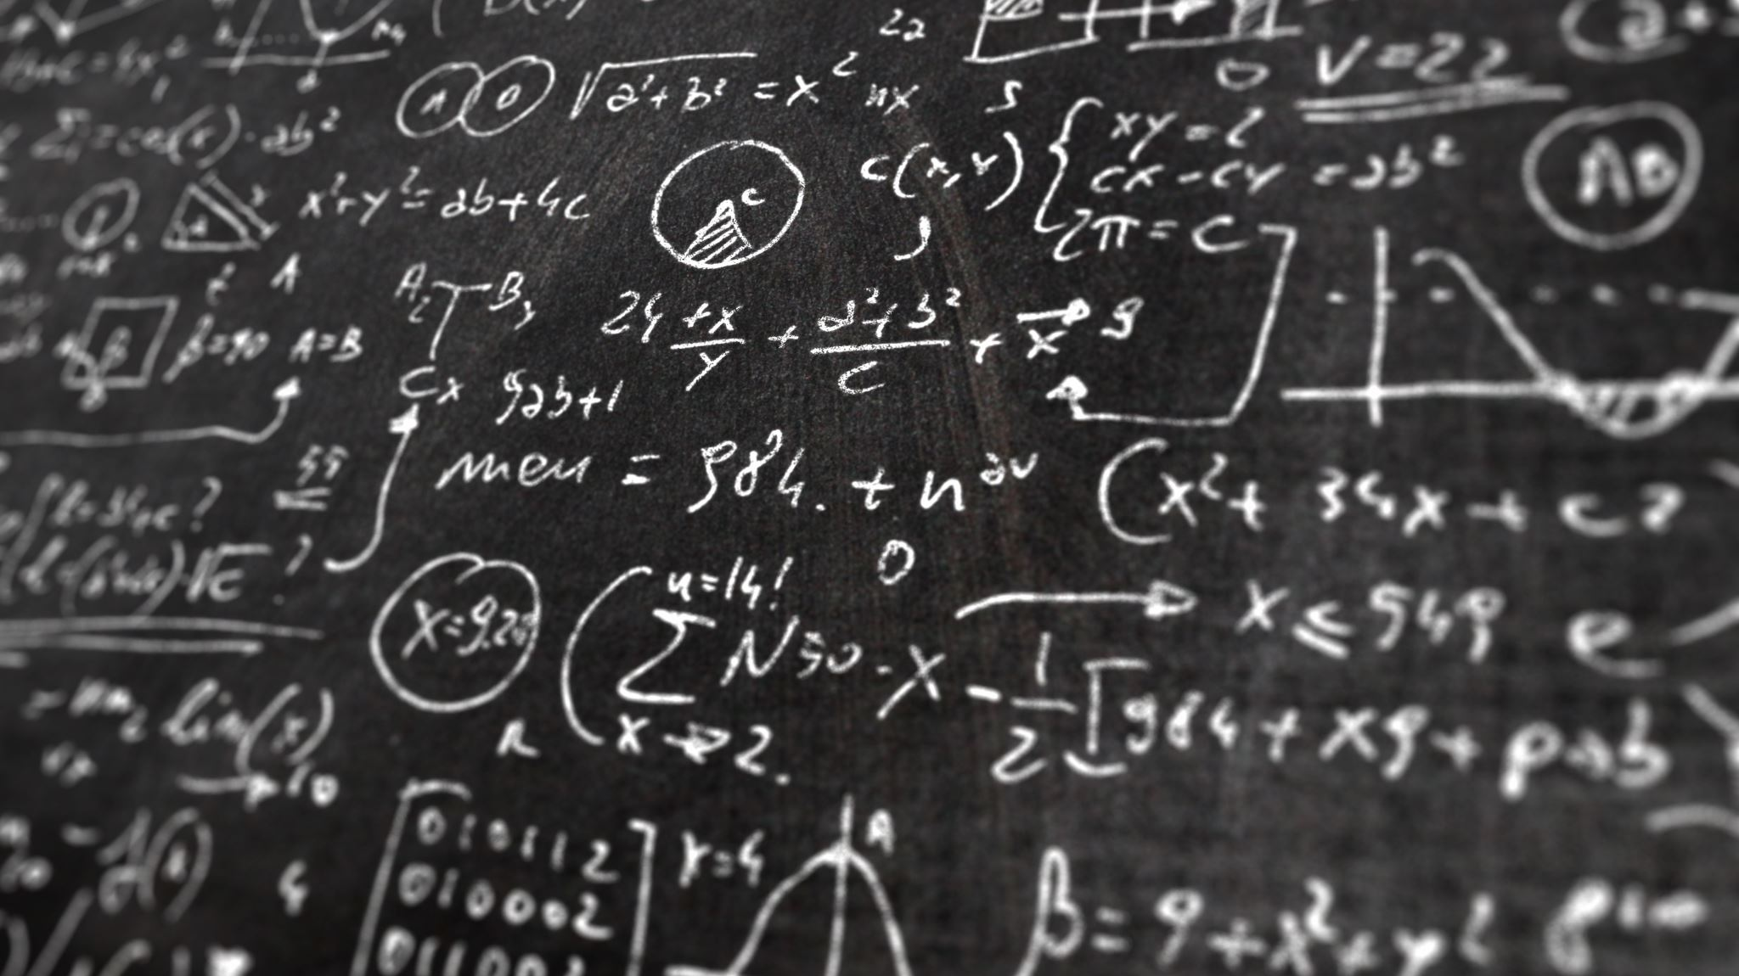
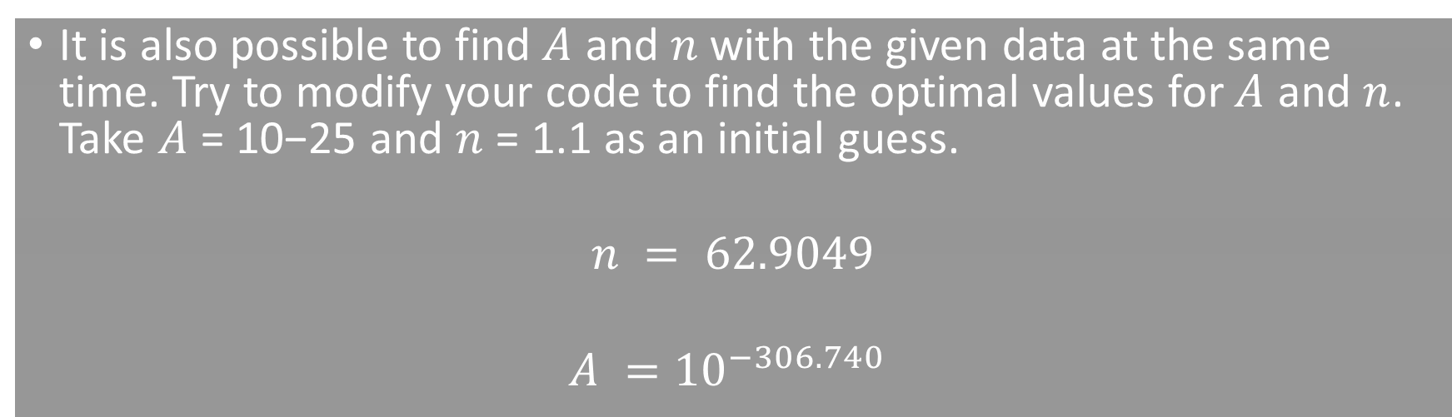
Task 4
It is also possible to find $A$ and $n$with the given data at the same time. Try to modify your code to find the optimal values for $A$ and $n$. Take $A$ = 10−25 and $n$ = 1.1 as an initial guess.
$$n = 62.9049$$
$$A ={10}^{−306.740}$$
ILOGICAL VALUES!

Slide 8
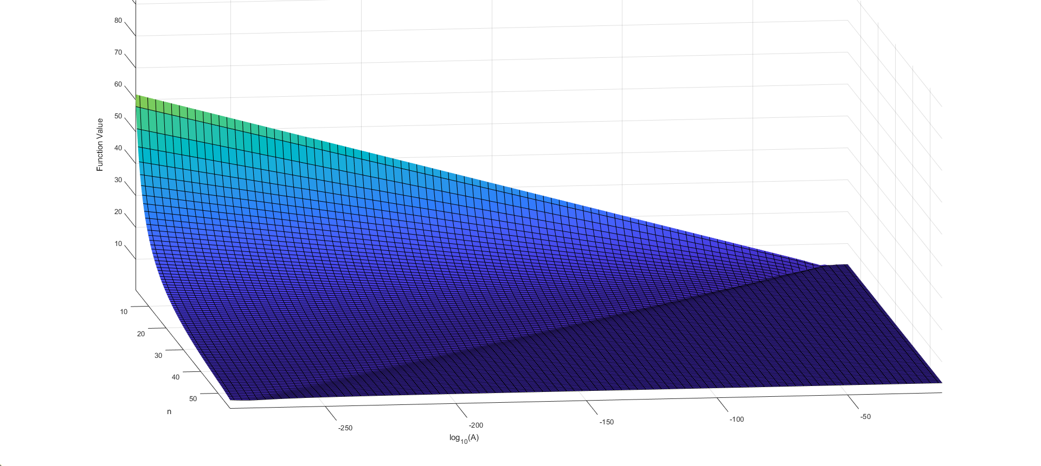
Surface graph of the objective function

Slide 9

Task 5
Redo Task 4 with some other initial guess. What can you say about your result
in Task 4? Which result from all these tasks is the optimal solution?

Slide 10

Task 6
Is it possible to do task 1 and task 2 iteratively to find the optimal solution for both $A$ and $n$?

Slide 11
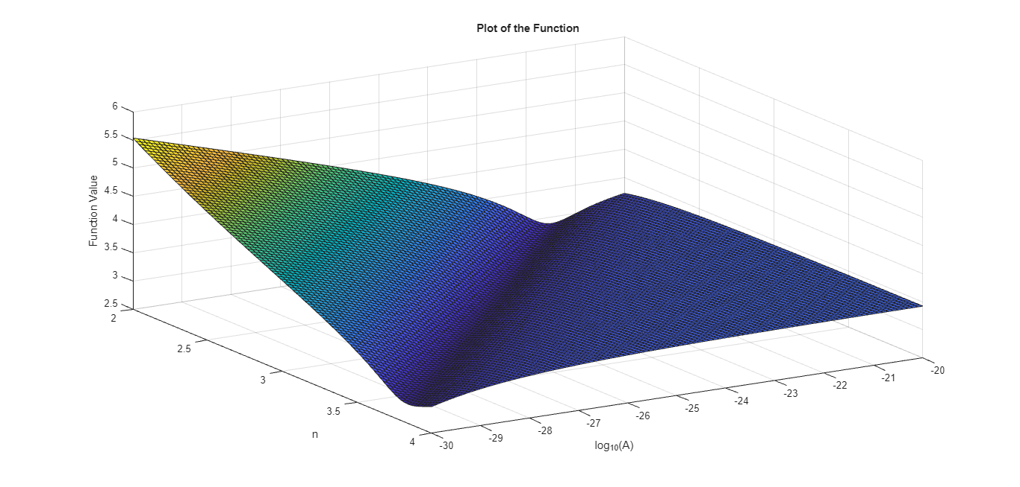
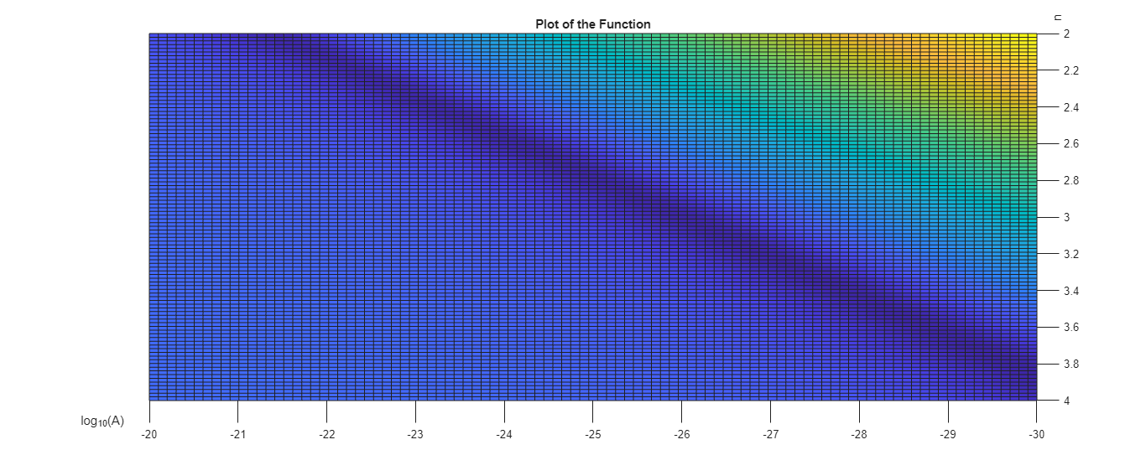
Impossible!
Constant A
Constant n

Slide 12

Task 7
$H_{i}(x)={\left(−a_{i}\left(x\right)\frac{n+2}{2A}{\left(ρg\right)}^{−n}{{\left|\frac{ⅆh}{ⅆx}\right|}_{i}}^{1−n}{{\left(\frac{dh}{dx}\right)}_{i}}^{−1}\right)}^{\frac{1}{n+z}}$
Error: $f_{i}(x)=H_{i}(x)−H_{i}^{obs} (x)$
Objective function
$$f=\sum_{i}{f_{i}^{2}}$$
Same results as in Task 4.

Slide 13

Conclusion
Summarize findings and highlight optimal solutions obtained.

